Slide 1
CSE 1102 Fundamentals of Programming Lecture #9
Spring 2017
Computer Science & Engineering Program
School of Electrical Engineering & Computing
Adama Science & Technology University

Slide 2
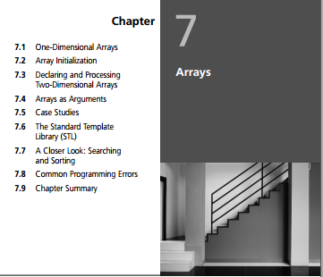
Outline
Arrays
One-dimensional arrays
Array initialization
Declaring and processing two-dimensional arrays
Arrays as arguments
Pointers
Addresses and pointers
Array names as pointers
Pointer arithmetic
Passing addresses
Case Studies: Statistical Analysis
[Data Processing] Students’ Grading
Reading assignment
Chapter 7 of the textbook
Chapter 10 of the textbook
Read about <cstring> library
Read about Standard Template Library and Vectors

Slide 3
One-Dimensional Arrays
One-dimensional array: A list of related values with the same data type, stored using a single group name (called the array name)
Syntax:
dataType arrayName[number-of-items]
By convention, the number of items is first declared as a constant, and the constant is used in the array declaration

Slide 4
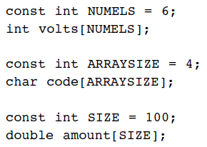
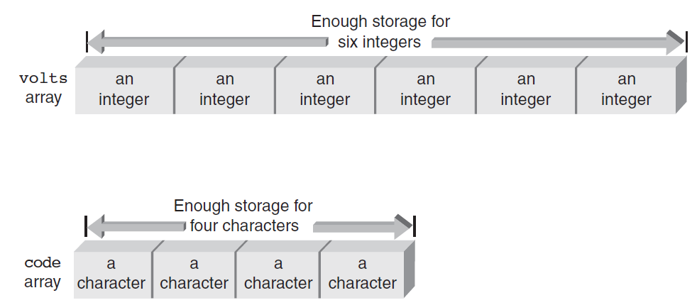
One-Dimensional Arrays (continued)
Figure 7.1 The volts and code arrays in memory

Slide 5
One-Dimensional Arrays (continued)
Element: An item in the array
Array storage of elements is contiguous
Index (or subscript) of an element: The position of the element within the array
Indexes are zero-relative
To reference an element, use the array name and the index of the element

Slide 6
One-Dimensional Arrays (continued)
Index represents the offset from the start of the array
Element is also called indexed variable or subscripted variable
Subscripted variable can be used anywhere that a variable can be used
Expressions can be used within the brackets if the value of the expression
Yields an integer value
Is within the valid range of subscripts

Slide 7
One-Dimensional Arrays (continued)
All of the elements of an array can be processed by using a loop
The loop counter is used as the array index to specify the element
Example:
sum = 0;
for (i=0; i<5; i++)
sum = sum + temp[i];

Slide 8
Input and Output of Array Values
Array elements can be assigned values interactively using a cin stream object
Out of range array indexes are not checked at compile-time
May produce run-time errors
May overwrite a value in the referenced memory location and cause other errors
Array elements can be displayed using the cout stream object

Slide 9
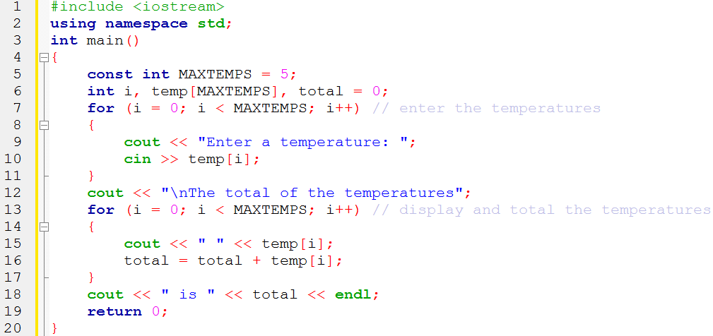
Input and Output of Array Values

Slide 10
Array Initialization
Array elements can be initialized in the array declaration statement
Example:
int temp[5] = {98, 87, 92, 79, 85};
Initialization:
Can span multiple lines, because white space is ignored in C++
Starts with array element 0 if an insufficient number of values is specified
If initializing in the declaration, the size may be omitted

Slide 11
Array Initialization
char array will contain an extra null character at the end of the string
Example:
char codes[] = “sample”;

Slide 12
Array Initialization

Slide 13
Two-Dimensional Arrays
Two-dimensional array: Has both rows and columns
Also called a table
Both dimensions must be specified in the array declaration
Row is specified first, then column
Both dimensions must be specified when referencing an array element

Slide 14
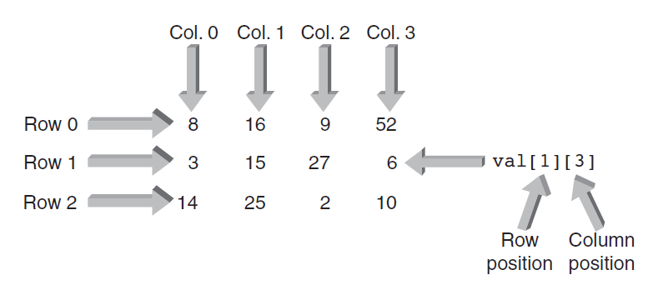
Two-Dimensional Arrays
Example:
int val[1][3];

Slide 15
Two-Dimensional Arrays
Two-dimensional arrays can be initialized in the declaration by listing values within braces, separated by commas
Braces can be used to distinguish rows, but are not required
Nested for loops are used to process two-dimensional arrays
Outer loop controls the rows
Inner loop controls the columns

Slide 16
Two-Dimensional Arrays: Displaying

Slide 17
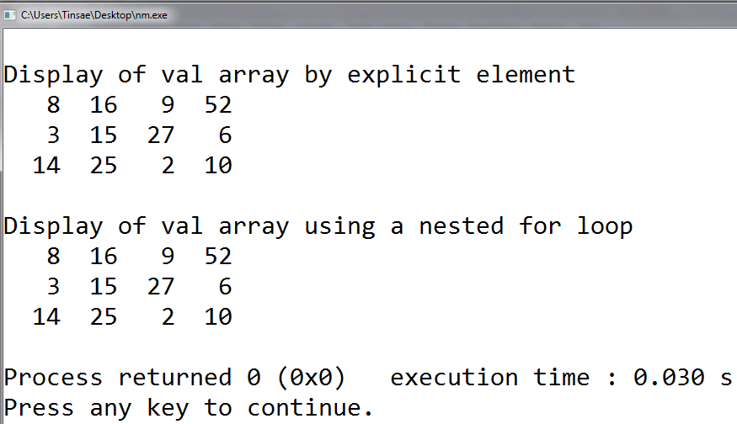
Two-Dimensional Arrays: Displaying

Slide 18
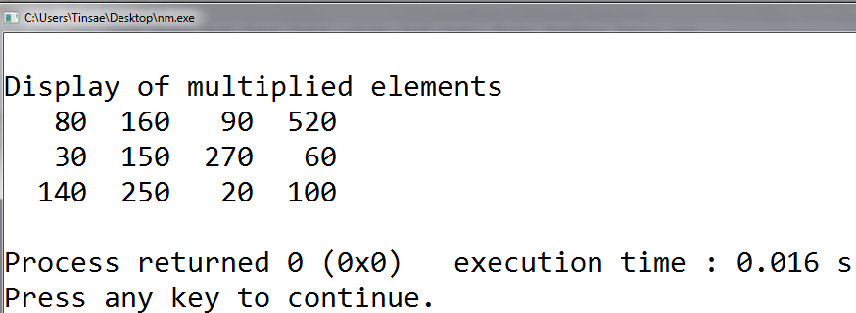
Two-Dimensional Arrays: Multiplying Elements

Slide 19
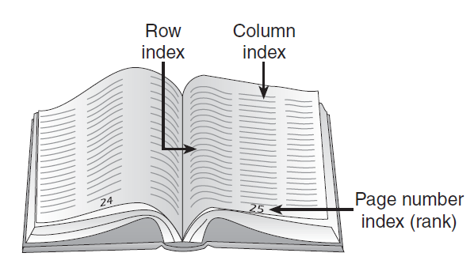
Larger Dimensional Arrays
Arrays with more than two dimensions can be created, but are not commonly used
Think of a three-dimensional array as a book of data tables

Slide 20
Arrays as Arguments
An individual array element can be passed as an argument just like any individual variable
The called function receives a copy of the array element’s value
Passing an entire array to a function causes the function to receive a reference to the array, not a copy of its element values
The function must be declared with an array as the argument
Single element of array is obtained by adding an offset to the array’s starting location

Slide 21
Arrays as Arguments

Slide 22
Arrays as Arguments: Finding Maximum

Slide 23
Arrays as Arguments: Using 2D arrays

Slide 24
Case Study 1: Statistical Analysis
A program is to be developed that accepts a list of a maximum of 100 numbers as input, determines both the average and standard deviation of the numbers, and then displays the result.

Slide 25
Step 1: Analyze the Problem
The statement of the problem indicates that
Two output values are required:
an average and a standard deviation.
The input item is a list of integer numbers.
The problem statement doesn’t specify the list size
make the application’s functions as general as possible, both functions will be designed to handle any size list passed to them.
This design also requires passing the exact number of array elements to each function at the time of the function call.
This capability means each function must be capable of receiving at least two input items as parameters
an array of arbitrary size and an integer number corresponding to the number of elements in the passed array.

Slide 26
Step 2: Develop a Solution
The I/O specifications determined from the problem analysis imply that each function’s parameter list must be capable of receiving at least two items
one parameter to accommodate the integer array
the second parameter to accept an integer.
The first function returns the average of the numbers in the passed array
The second function returns the standard deviation. These items are determined as follows:

Slide 27
Step 2: Develop a Solution

Slide 28
Step 3, 4: Code, Test and Correct the Solution

Slide 29
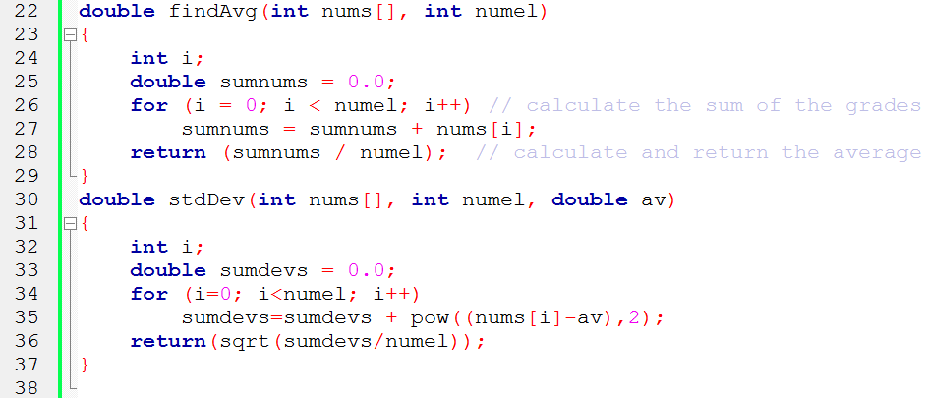
Step 3, 4: Code, Test and Correct the Solution

Slide 30
Case Study 2: Students’ Grading Program
A program that uses a two-dimensional array named grade to store and then display the grade records for a small class.
The class has four students, and the records include three quizzes.
Reads quiz scores for each student into the two-dimensional array grade
Compute the average score for each student
Compute the average score for each quiz.
Displays the quiz scores and the averages.

Slide 31
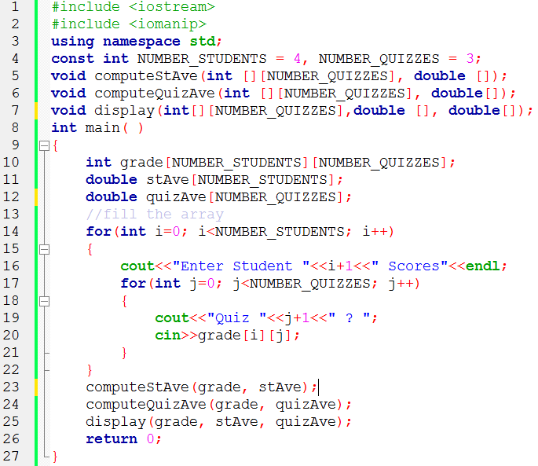
Case Study 2: Students’ Grading Program

Slide 32
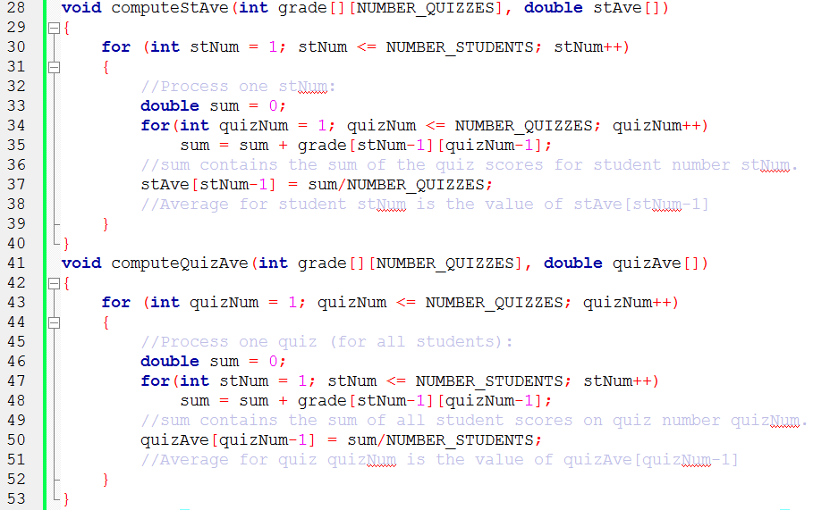
Case Study 2: Students’ Grading Program

Slide 33
Case Study 2: Students’ Grading Program

Slide 34
Testing the Program

Slide 35
Addresses and Pointers
The address operator, &, accesses a variable’s address in memory
The address operator placed in front of a variable’s name refers to the address of the variable
&num means the address of num

Slide 36
Addresses and Pointers

Slide 37
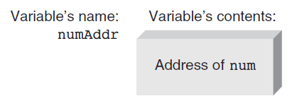
Storing Addresses
Addresses can be stored in a suitably declared variable

Slide 38
Storing Addresses
Example statements store addresses of the variable m, list, and ch in the variables d, tabPoint, and chrPoint
d = &m;
tabPoint = &list;
chrPoint = &ch;
d, tabPoint, and chrPoint are called pointer variables or pointers

Slide 39
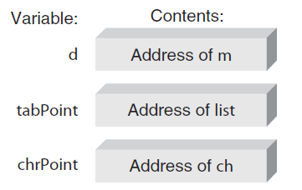
Storing Addresses

Slide 40
Using Addresses
To use a stored address, C++ provides the indirection operator, *
The * symbol, when followed by a pointer, means “the variable whose address is stored in”
*numAddr means the variable whose address is stored in numAddr

Slide 41
Using Addresses

Slide 42
Using Addresses
When using a pointer variable, the value that is finally obtained is always found by first going to the pointer for an address
The address contained in the pointer is then used to get the variable’s contents
Since this is an indirect way of getting to the final value, the term indirect addressing is used to describe it

Slide 43
Declaring Pointers
Like all variables, pointers must be declared before they can be used to store an address
When declaring a pointer variable, C++ requires specifying the type of the variable that is pointed to
Example: int *numAddr;
To understand pointer declarations, reading them “backward” is helpful
Start with the indirection operator, *, and translate it as “the variable whose address is stored in” or “the variable pointed to by”

Slide 44
Declaring Pointers

Slide 45
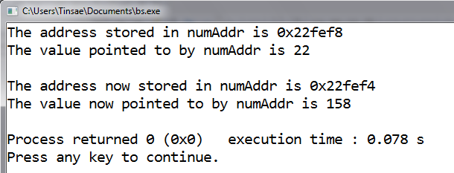
Pointers: Example

Slide 46
References and Pointers
A reference is a named constant for an address
The address named as a constant cannot be changed
A pointer variable’s value address can be changed
For most applications, using references rather than pointers as arguments to functions is preferred
Simpler notation for locating a reference parameter
Eliminates address (&) and indirection operator (*) required for pointers
References are automatically dereferenced, also called implicitly dereferenced

Slide 47
Array Names as Pointers
There is a direct and simple relationship between array names and pointers
Using subscripts, the fourth element in grade is referred to as grade[3], address calculated as:
&grade[3] = &grade[0] + (3 * sizeof(int))

Slide 48
Array Names as Pointers

Slide 49
Array Names as Pointers

Slide 50
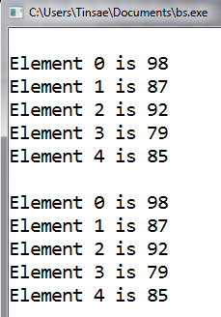
Array Names as Pointers: Example

Slide 51
Pointer Arithmetic
Pointer variables, like all variables, contain values
The value stored in a pointer is a memory address
By adding or subtracting numbers to pointers you can obtain different addresses
Pointer values can be compared using relational operators (==, <, >, etc.)

Slide 52
Pointer Arithmetic

Slide 53
Pointer Arithmetic

Slide 54
Pointer Arithmetic: Example

Slide 55
Pointer Initialization
Increment and decrement operators can be applied as both prefix and postfix operators
Of the four possible forms, *ptNum++ is most common
Allows accessing each array element as the address is “marched along” from starting address to address of last array element

Slide 56
Pointer Initialization
Pointers can be initialized with they are declared
int *ptNum = &miles;
Pointers to arrays can also be initialized when they are declared
double *zing = &volts[0];

Slide 57
Passing Addresses
Reference pointers can be used to pass addresses through reference parameters
Implied use of an address
Pointers can be used explicitly to pass addresses with references
Explicitly passing references with the address operator is called pass by reference
Called function can reference, or access, variables in the calling function by using the passed addresses

Slide 58
Passing Addresses: Example

Slide 59
Passing Addresses

Slide 60
Passing Addresses

Slide 61
Passing Arrays
When an array is passed to a function, its address is the only item actually passed
“Address” means the address of the first location used to store the array
First location is always element zero of the array

Slide 62
Passing Arrays

Slide 63
Passing Arrays: Example

